Slide 1
Nexus of Nurture
Muiz Aminu, Asma Sulieman, Cadin Rudoll, John Shore

Slide 2
OBSERVATIONS
UHS
No real Filters
Complex
Limited dates
Zocdoc
Better Filters
Limited availability
Reviews of doctors
Lack of diversity

Slide 3
Problems
Complex layouts
Limited Filters
Limited Options
Lack of accessibility tools
Lack of personalization
Lack of Health record integration

Slide 4
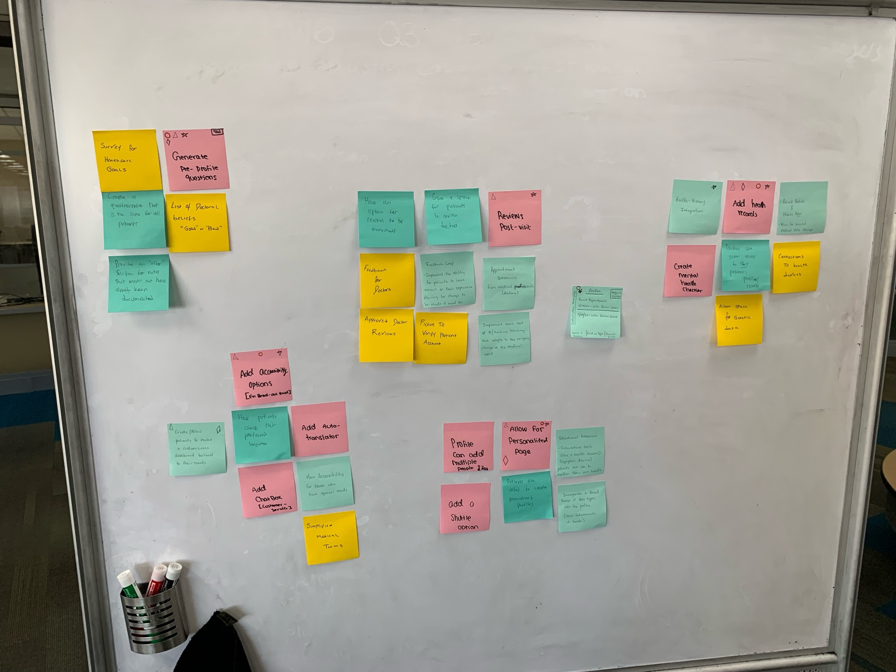
Brainstorm
How can we create a more personalized patient profile?
Original Thoughts
Health History Integration
Post Appointment Summaries
Additional Accessibility Options

Slide 5
Post-Brainstorming
What went well?
What are some of the difficulties?
What can be done differently?

Slide 6
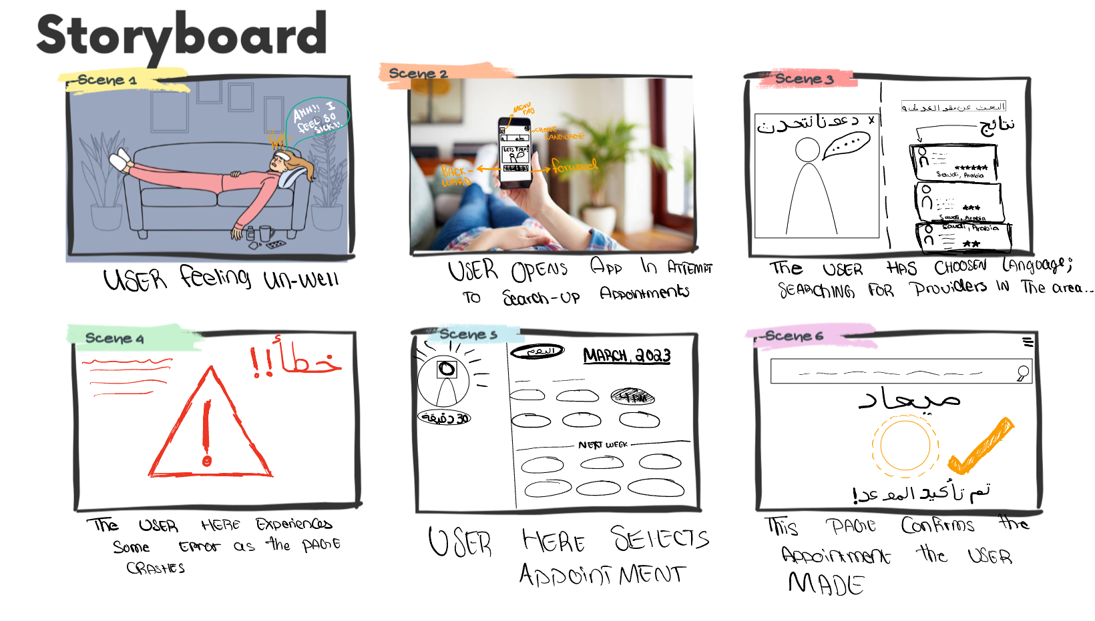
Storyboard
Accessing post appointment summaries
Accessing medical history / updating medical history
Making an appointment when necessary

Slide 7
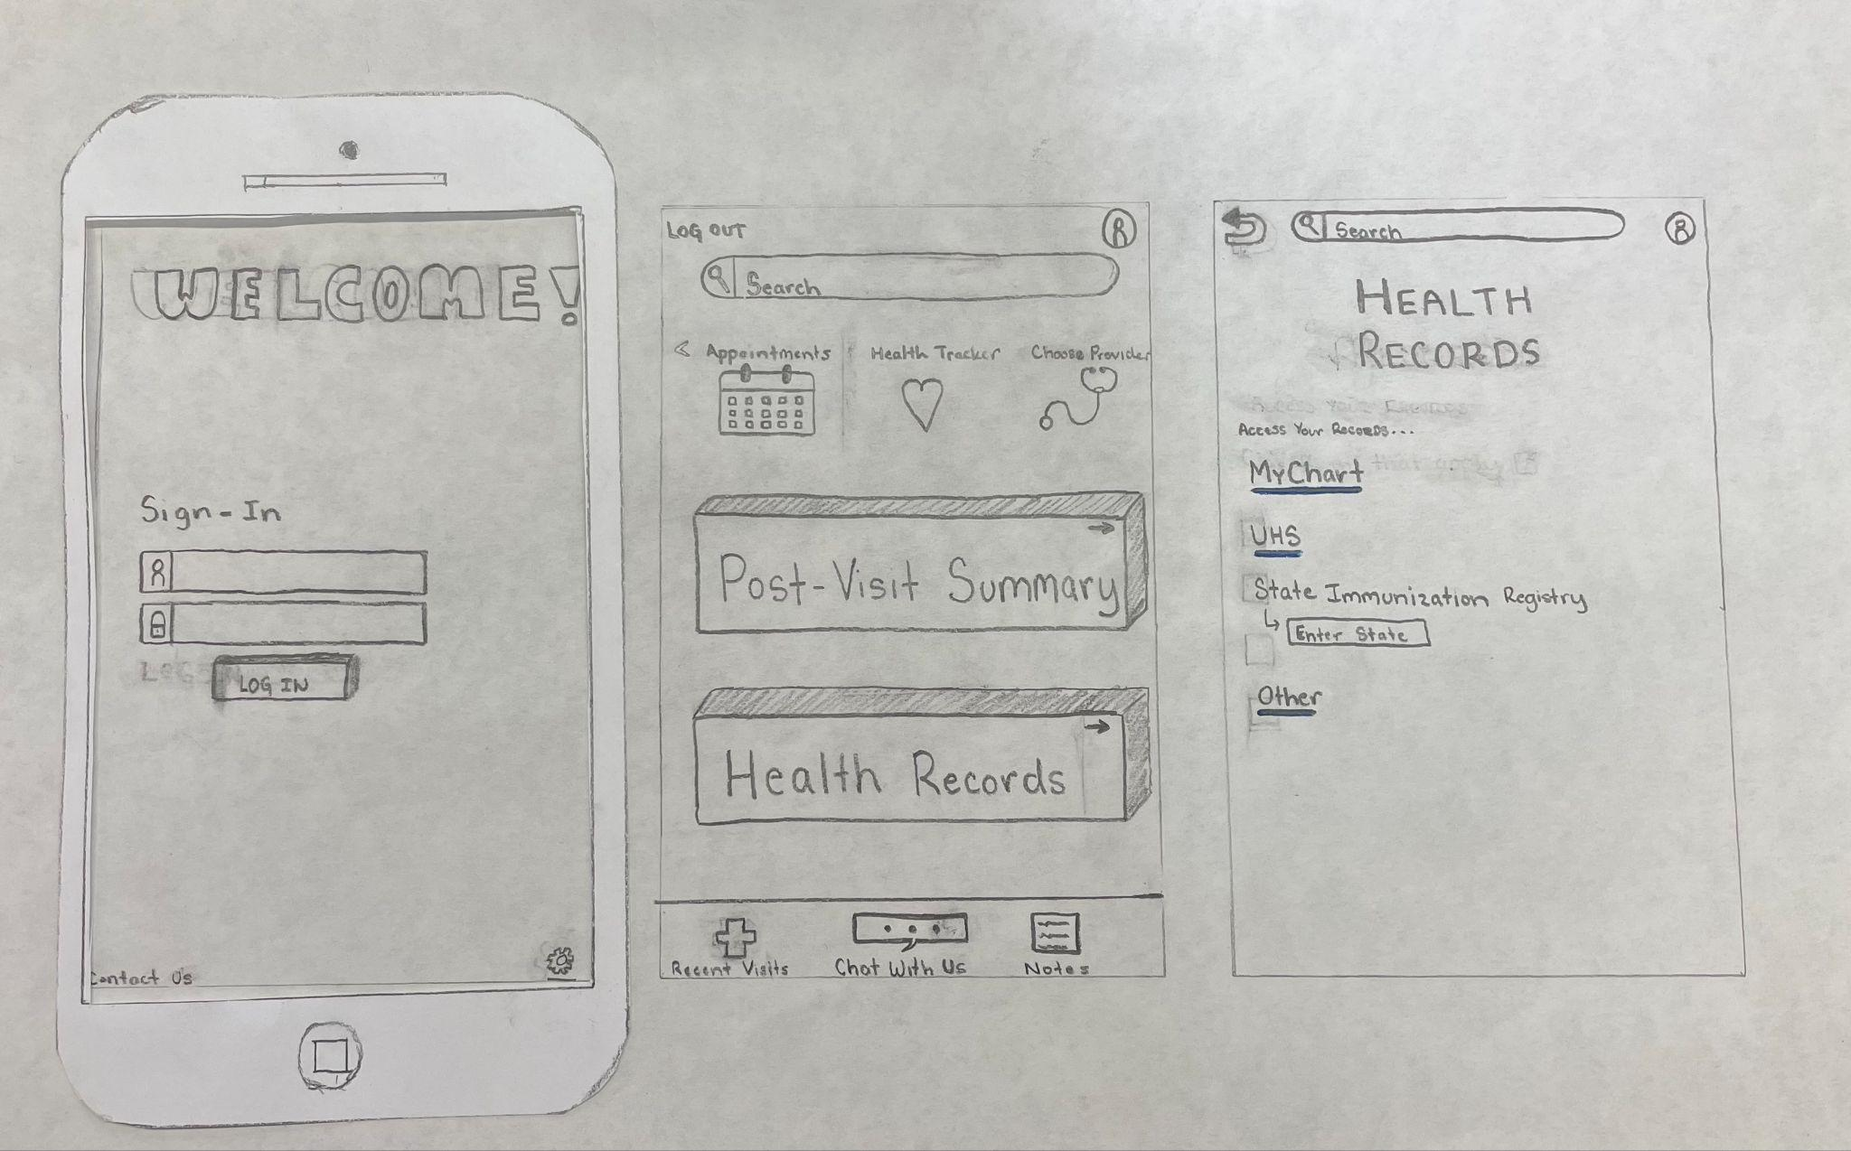
Paper Prototype
User were tasked with accessing/uploading their health records to a website

Slide 8
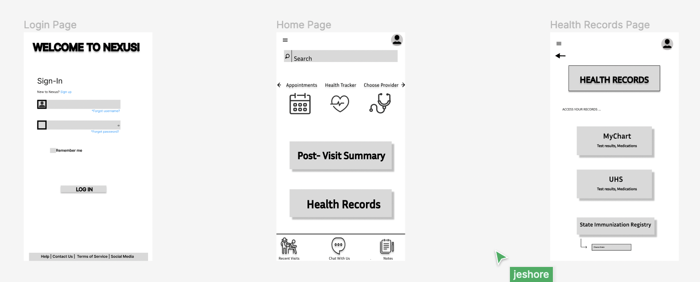
Wireframes
Login Page
User can perform different tasks related to logging in
Home Page
All the different options for the user to engage with the website
Health Records Page
Access to their health records

Slide 9
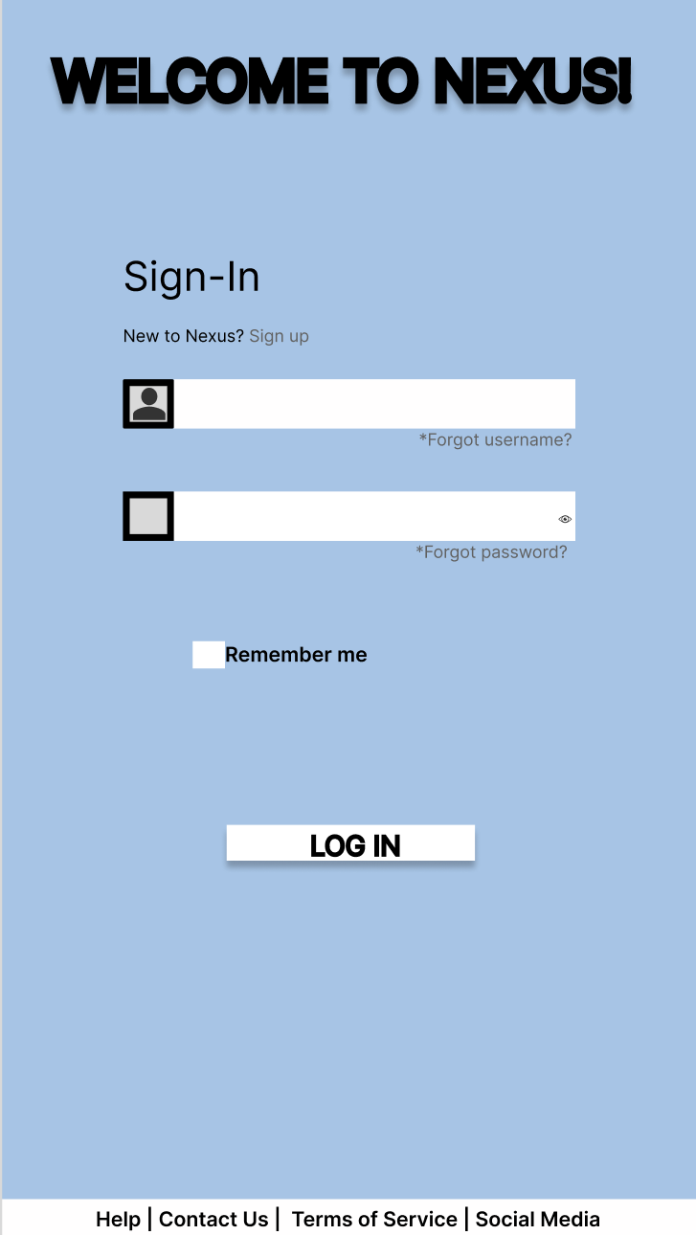
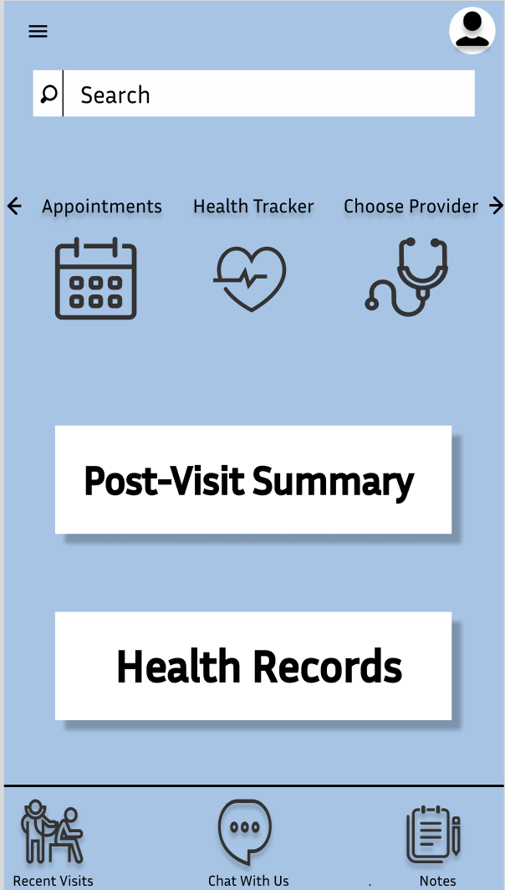
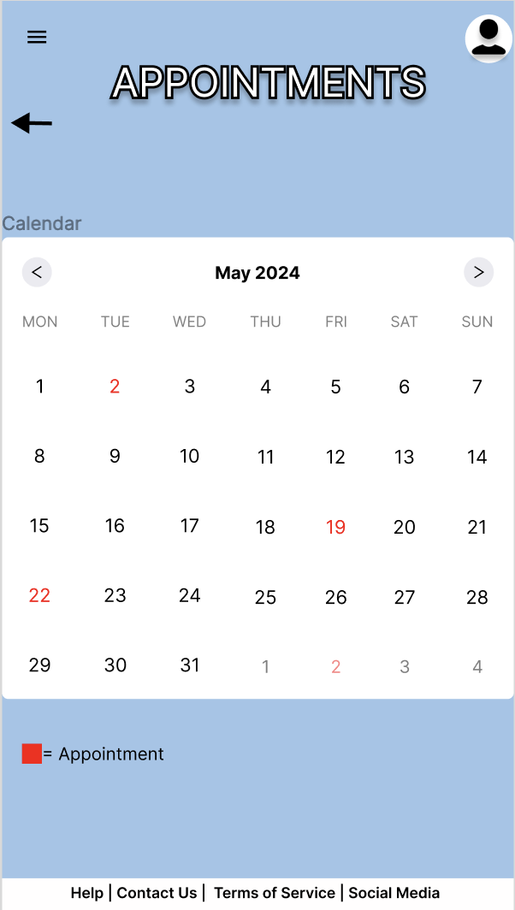
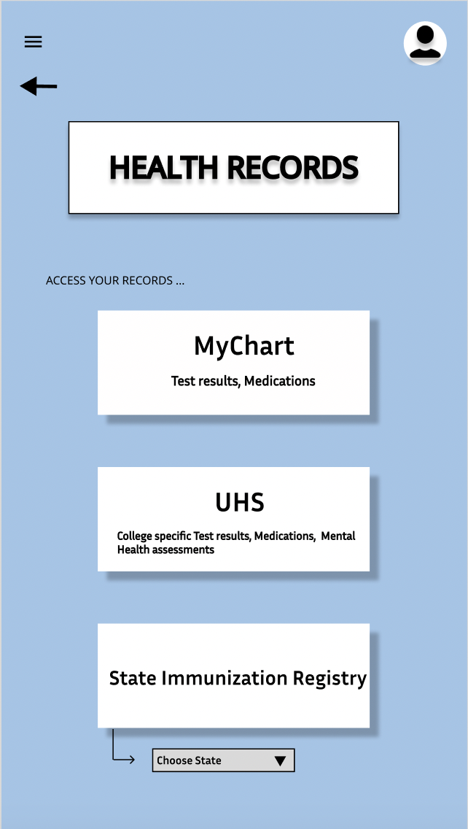
FINAL DESIGN
Home Page
Login Page
Health Records Page
Appointments
Menu Tab

Slide 10
What’s Next?
Option to choose preferred language
Language
Finding a healthcare provider
Video Demo
Additional Advanced Filters
Personalize Page
Advanced Personalization

